Slide 1

Visualizing Data in R using ggplot2
Lauren Nichols
Lmn7@duke.edu

Slide 2


Visualizing Data in R using ggplot2
Lauren Nichols
Lmn7@duke.edu

Slide 3
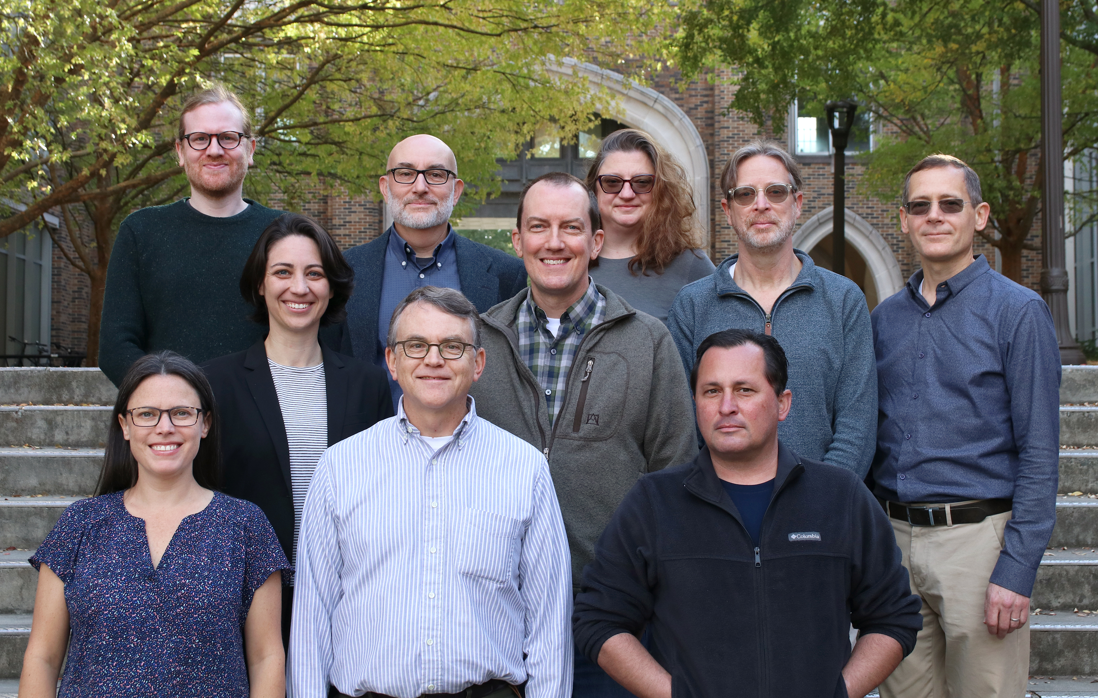
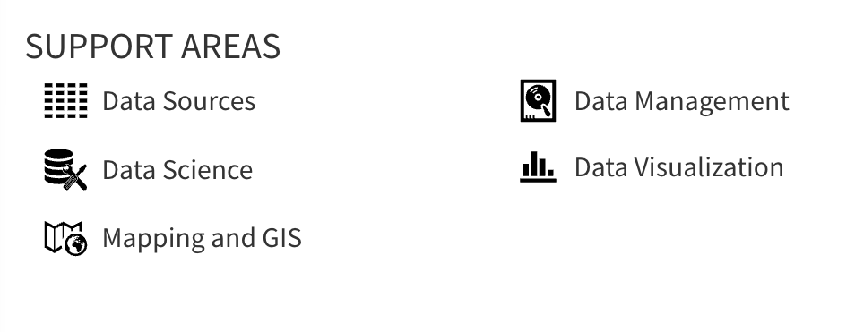
Center for Data & Visualization Sciences (CDVS)
AskData@duke.edu
Notes:
We offer workshops and individual consultation

Slide 4


VS

Slide 5
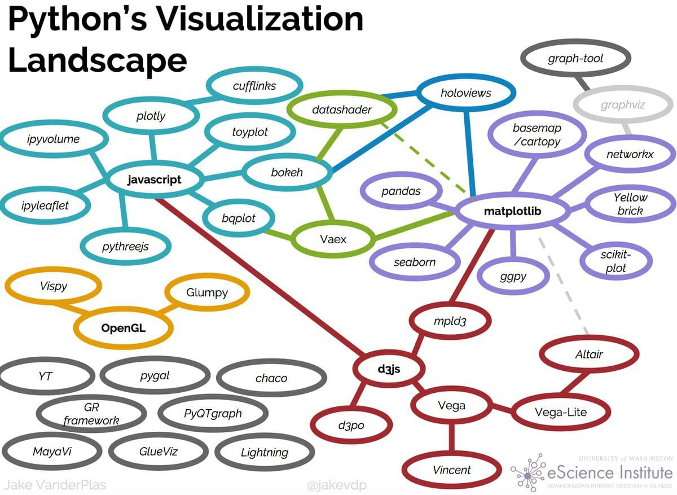

Slide 6
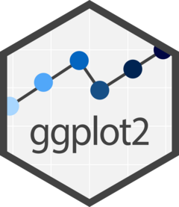
leaflet
r2d3

Slide 8
“gg” in ggplot2 stands for “Grammar of Graphics”
Notes:
(move it over)

Slide 9
Data
Aesthetics
Geometries
Statistics
“gg” in ggplot2 stands for “Grammar of Graphics”
Graphics are built by layering elements
Scales
Themes
Notes:
(move it over)

Slide 10
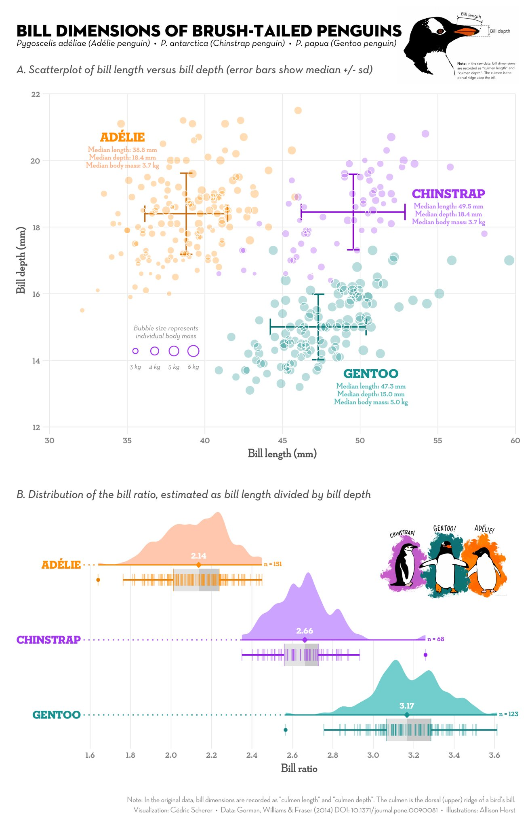
Notes:
Integration with analysis in R
Succinct
Versatile
Publication ready graphics
(or at least pretty close to it)

Slide 11
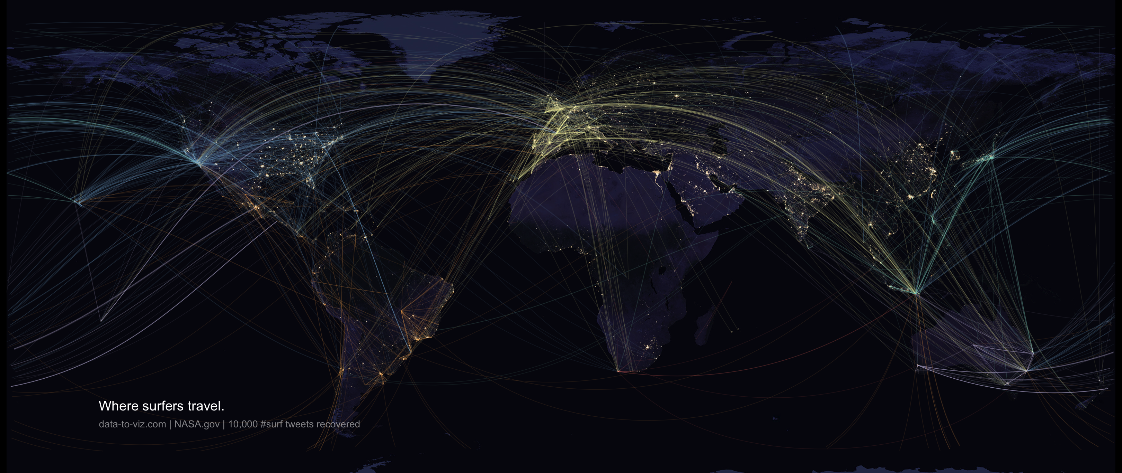
Notes:
Bespoke figures

Slide 12
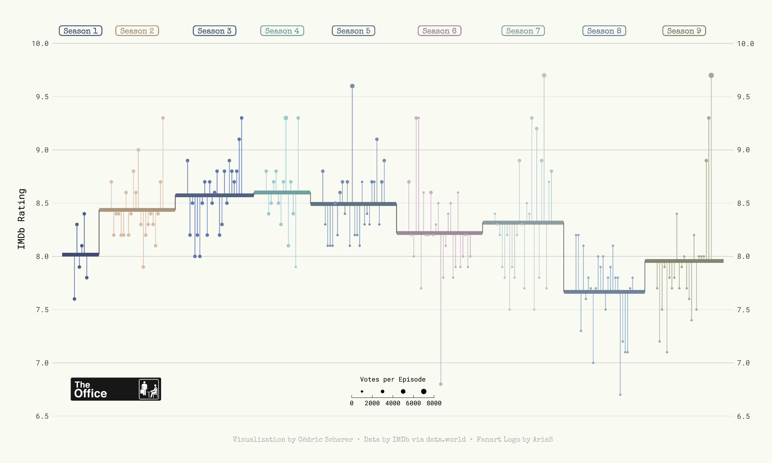

Slide 13
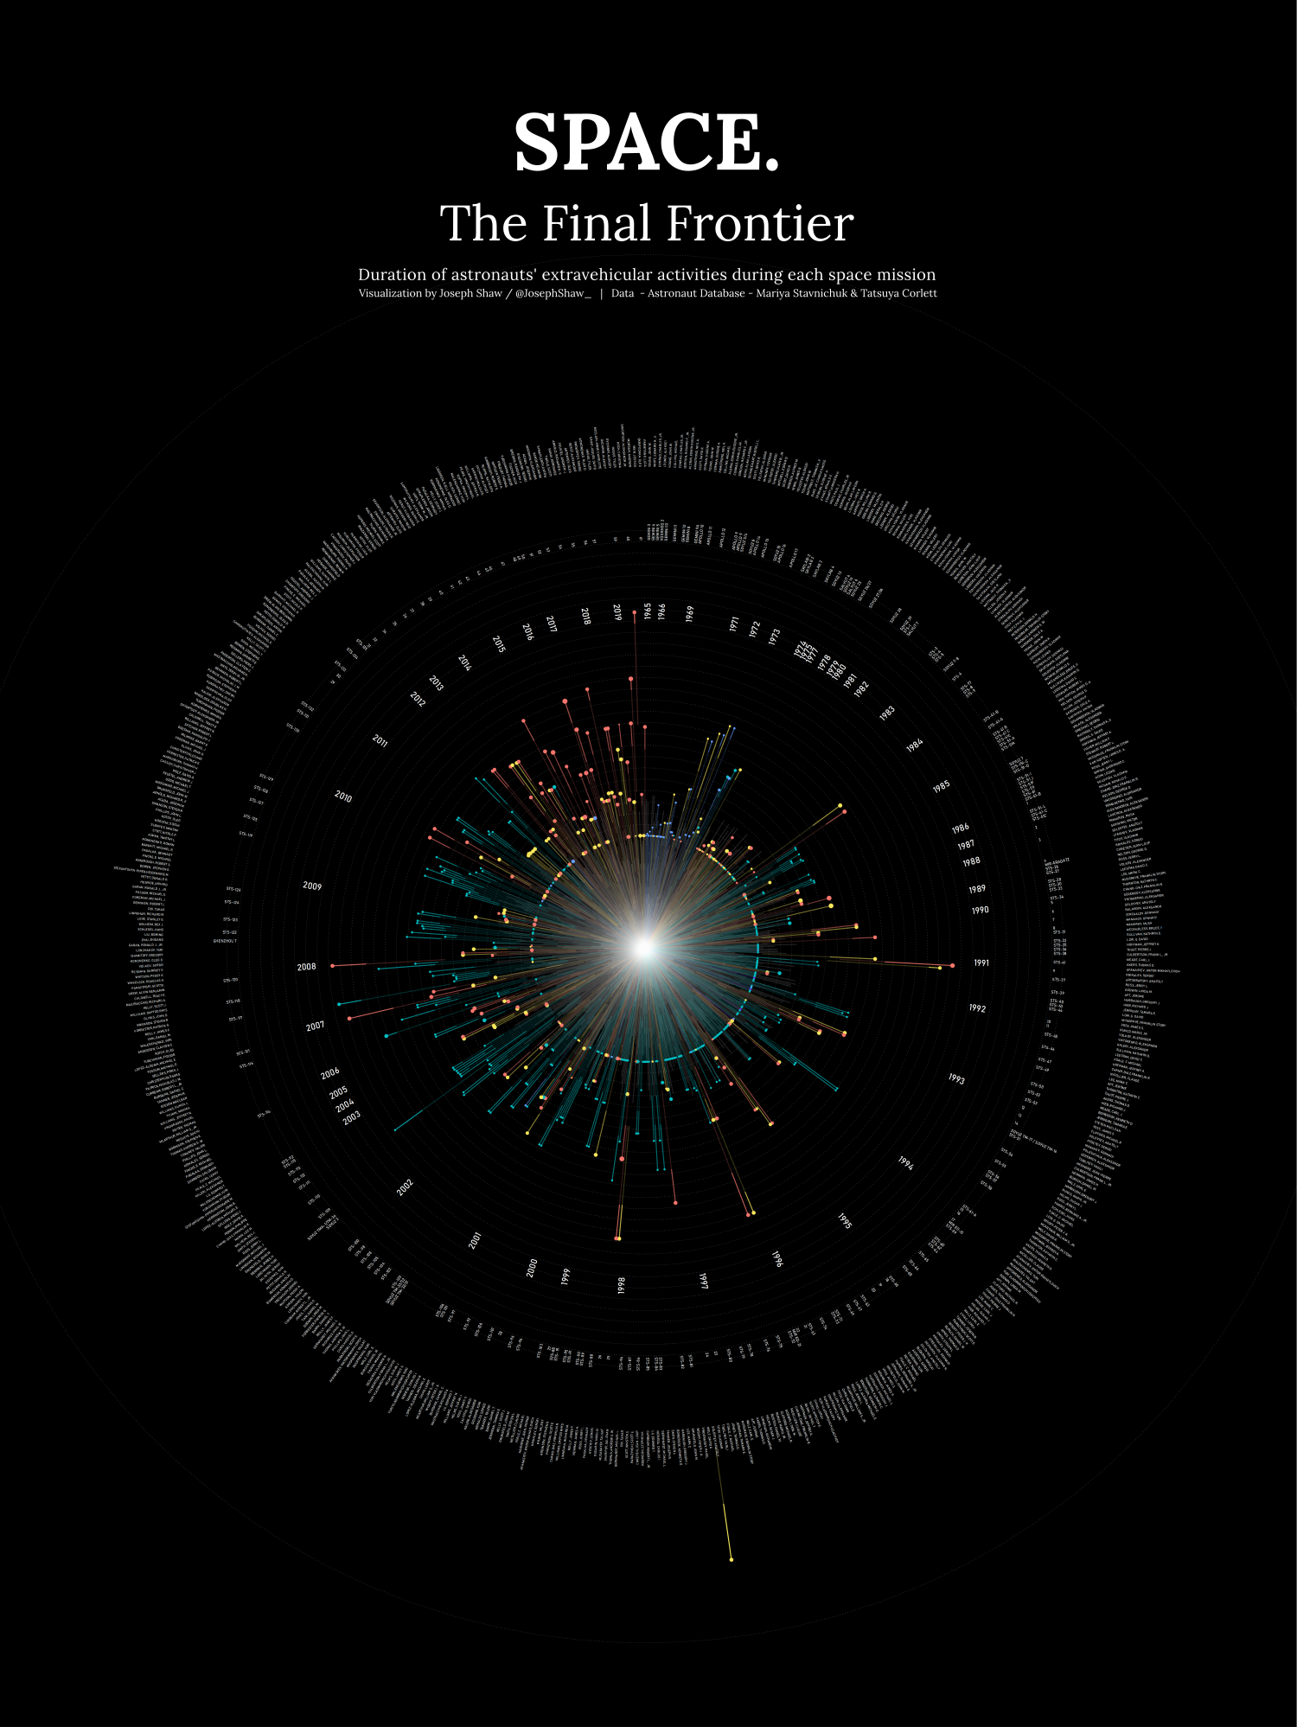
github.com/joseph-shaw/tidytuesday/

Slide 14
github.com/joseph-shaw/tidytuesday/

Slide 15
Data
ggplot(
data = yourdata
,
Mapping
mapping = aes(x axis, y axis)
) +
geometry function
+
Geometries
statistics function
+
Statistics
scales function
+
themes function
Scales
Themes
Notes:
method chaining with a +

Slide 16
Data
ggplot(
data = yourdata
,
Aesthetics
mapping = aes(x axis, y axis)
) +
geometry function
+
Geometries
statistics function
+
Statistics
scales function
+
themes function
Scales
Themes
Notes:
method chaining with a +

Slide 17
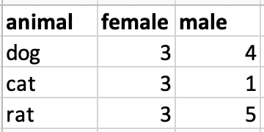
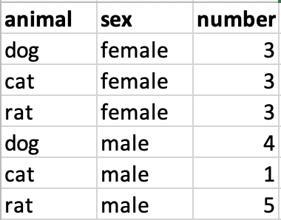
Data Format
Wide data
Long data

Slide 18
Data Format
Wide data
Long data
f

Slide 19
Data Format
Wide data
Long data
f
Wide_data = spread(Long_data, sex, number)

Slide 20
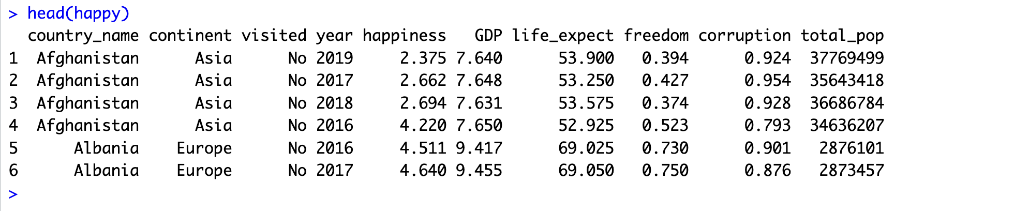

Slide 21
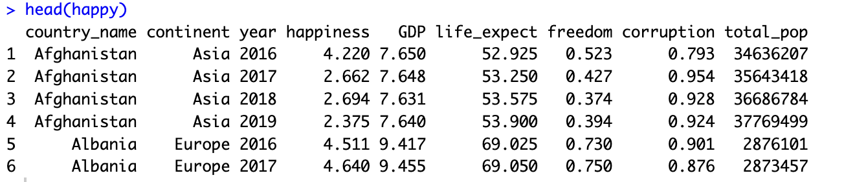

Slide 22
Data
,
) +
ggplot(
data = yourdata
,
aes(x axis, y axis)
Aesthetics
geometry function
Geometries
Notes:
method chaining with a +

Slide 23
Data
,
) +
ggplot(
data = yourdata
,
aes(x axis, y axis)
Aesthetics
geometry function
Geometries
ggplot(
data = happy
,
) +
aes(x=GDP, y=happiness)
geom_point()
Notes:
method chaining with a +

Slide 24
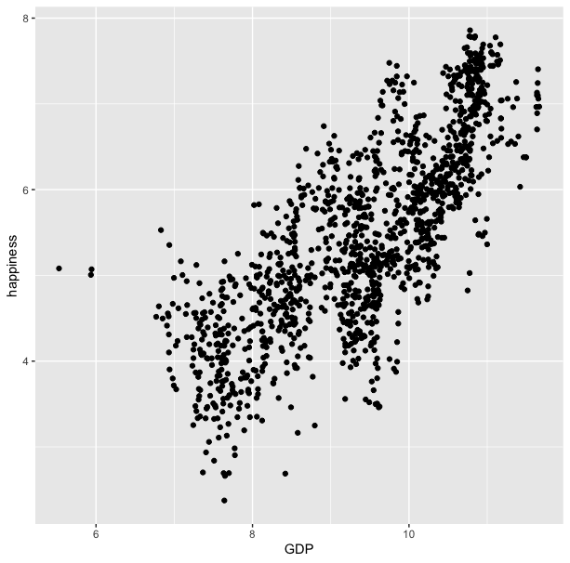
ggplot(
data = happy
,
) +
aes(x=GDP, y=happiness)
geom_point()

Slide 25
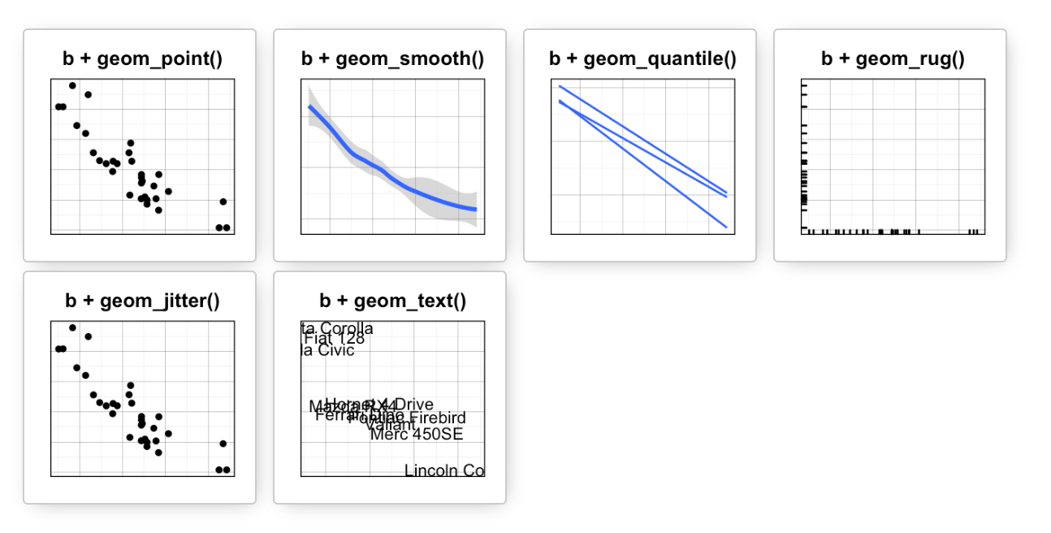
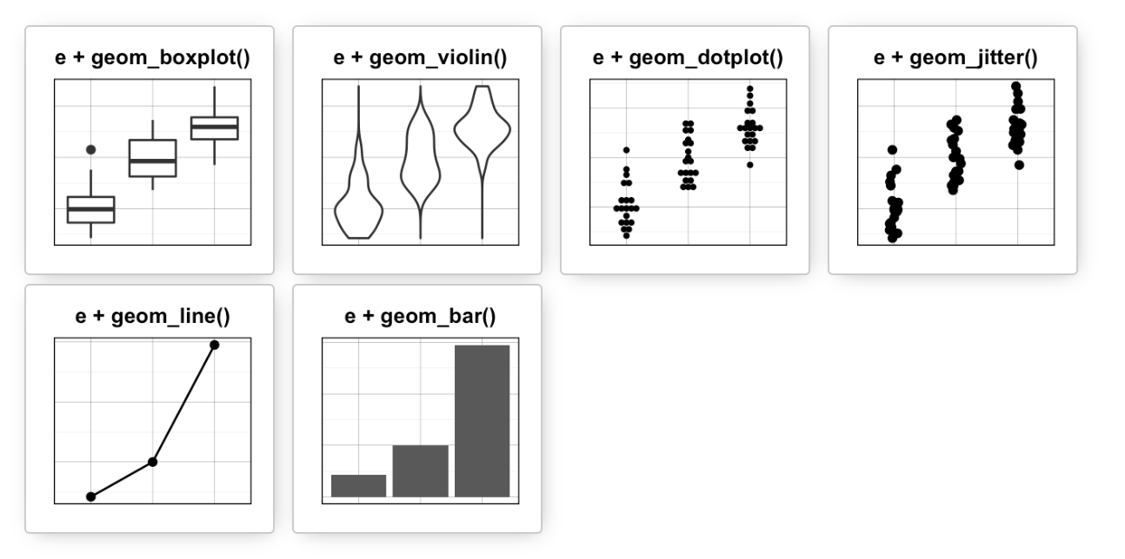
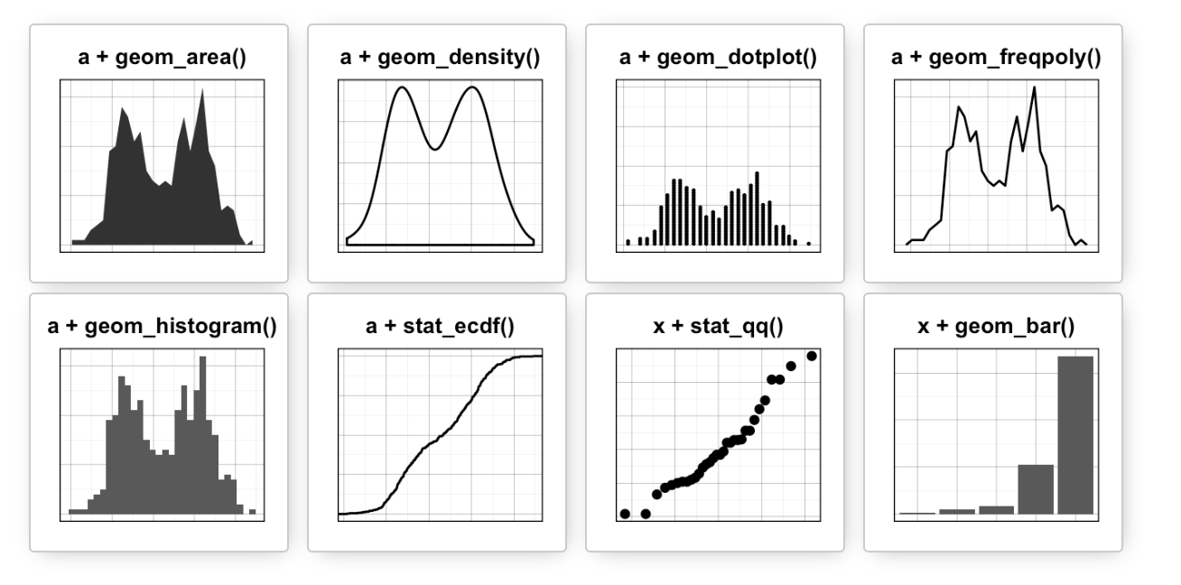
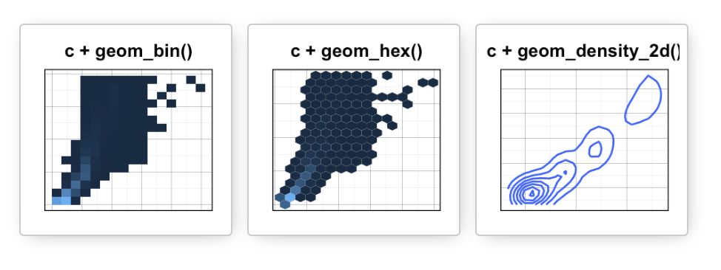
Data
Aesthetics
Geometries
Statistics
Scales
Themes
Exporting

Slide 26
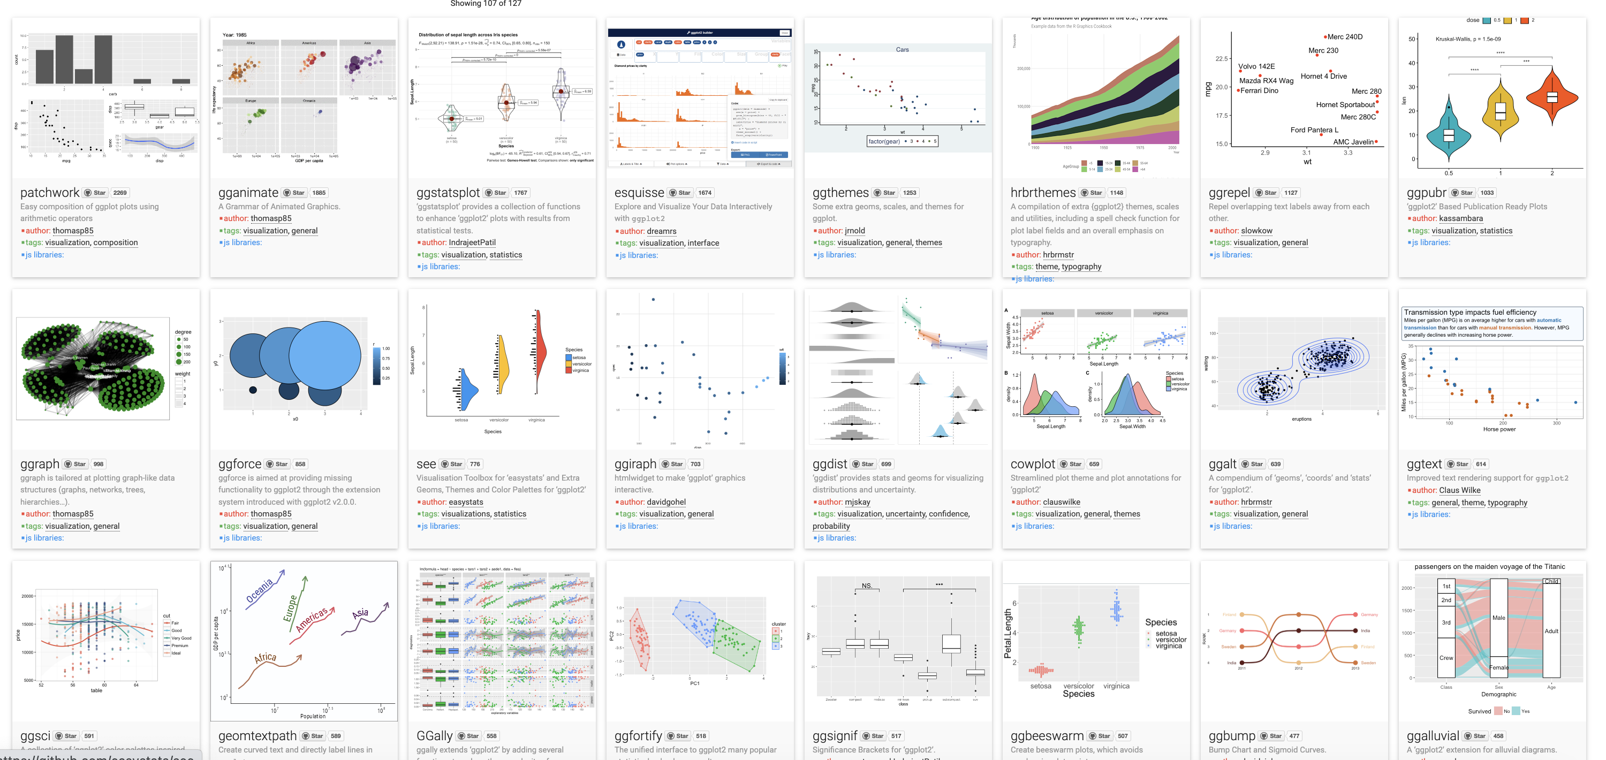
Over 120 ggplot2 extension libraries

Slide 27
ggplot(
,
data = happy
aes(GDP, happiness)
) +
geom_point()
“and then…”
dplyr %>% or |>
ggplot +

Slide 28
ggplot(data = happy, aes(x=GDP, y=happiness))+
geom_point()

Slide 29
ggplot(
data = happy
,
) +
aes(x=GDP, y=happiness)
geom_point()

Slide 30
ggplot(
data = happy
,
aes(x=GDP, y=happiness)
) +
geom_point()
Notes:
ADD SLIDE BEF ORE WITHOUT Xs

Slide 31
ggplot(
data = happy
,
aes(x=GDP, y=happiness)
) +
geom_point()
ggplot(
happy
aes(GDP, happiness)
) +
,
geom_point()

Slide 32
ggplot(
data = happy
,
aes(x=GDP, y=happiness)
) +
geom_point()
ggplot(
happy
aes(GDP, happiness)
) +
,
geom_point()
ggplot(
) +
geom_point(
happy
aes(GDP, happiness)
,
)

Slide 33
ggplot(
data = happy
,
aes(x=GDP, y=happiness)
) +
geom_point()
ggplot(
happy
aes(GDP, happiness)
) +
,
geom_point()
ggplot(
) +
geom_point(
happy
aes(GDP, happiness)
,
)
,
happy
%>%
ggplot(
aes(GDP, happiness)
) +
geom_point()

Slide 34
ggplot(
data = happy
,
aes(x=GDP, y=happiness)
) +
geom_point()
ggplot(
happy
aes(GDP, happiness)
) +
,
geom_point()
ggplot(
) +
geom_point(
happy
aes(GDP, happiness)
,
)
,
happy
|>
ggplot(
aes(GDP, happiness)
) +
geom_point()
These all produce the same figure!

Slide 35
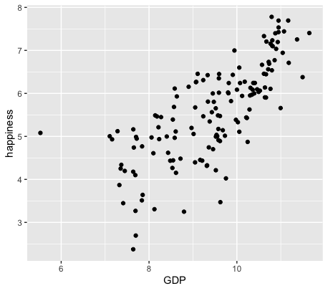
happy |>
filter(year == 2019) |>
ggplot(
aes(GDP, happiness)
) +
geom_point()

Slide 36
Aesthetics define any data that gets mapped to geometry
(such as color, size, shape, etc.)
ggplot(data = yourData,
aes(x = xaxis,y = yaxis))+
geom_point()
Notes:
method chaining with a +

Slide 37
Aesthetics define any data that gets mapped to geometry
(such as color, size, shape, etc.)
ggplot(data = happy,
aes(x = happiness,y = GDP,
shape= ,
size= ,
col= ))+
geom_point()
Notes:
method chaining with a +

Slide 39
ggplot(happy, aes(GDP, happiness)) +
geom_point()

Slide 40
ggplot(happy, aes(GDP, happiness)) +
geom_point(aes(col=continent))

Slide 41
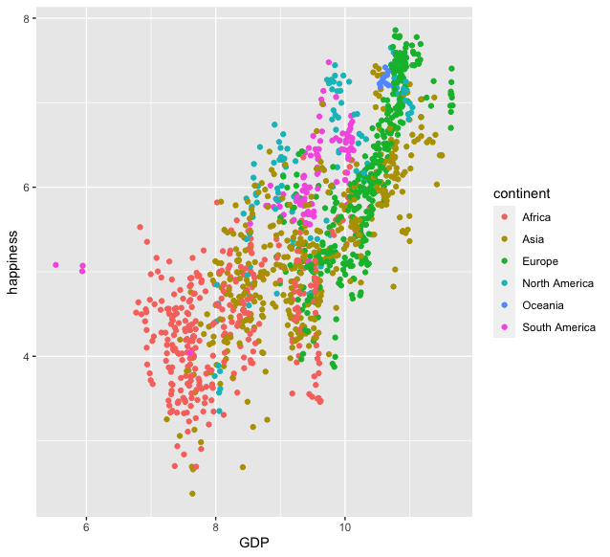
ggplot(happy, aes(GDP, happiness)) +
geom_point(aes(col=continent))

Slide 42
ggplot(happy, aes(GDP, happiness)) +
geom_point(aes(col=continent))
ggplot(happy, aes(GDP, happiness)) +
geom_point(col=‘blue’)

Slide 43
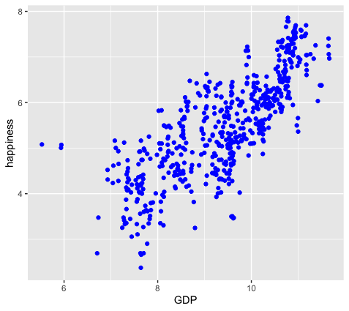
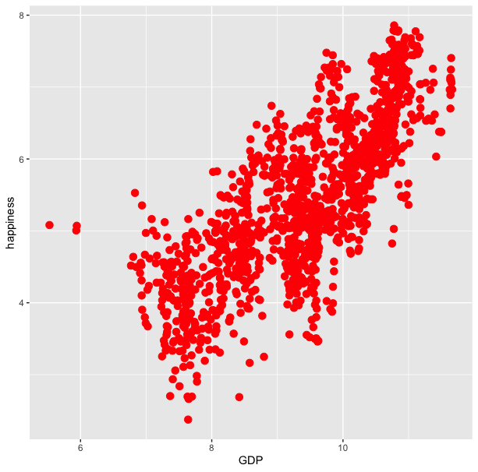
ggplot(happy, aes(GDP, happiness)) +
geom_point(aes(col=continent))
ggplot(happy, aes(GDP, happiness)) +
geom_point(col=‘blue’)

Slide 44
ggplot(happy, aes(GDP, happiness)) +
geom_point(aes(col=continent))
ggplot(happy, aes(GDP, happiness)) +
geom_point(col=‘blue’)
ggplot(happy, aes(GDP, happiness)) +
geom_point(aes(col=‘blue’))

Slide 45
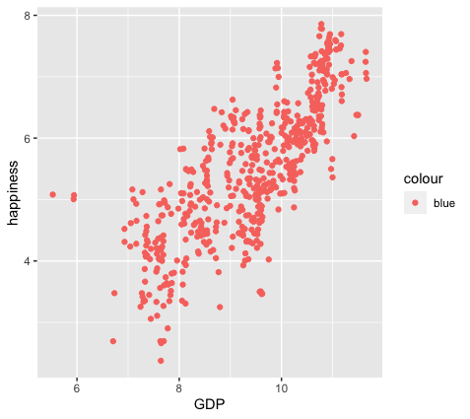
ggplot(happy, aes(GDP, happiness)) +
geom_point(aes(col=continent))
ggplot(happy, aes(GDP, happiness)) +
geom_point(col=‘blue’)
ggplot(happy, aes(GDP, happiness)) +
geom_point(aes(col=‘blue’))

Slide 46
colour
blue
blue
blue
blue
blue
blue
ggplot(happy, aes(GDP, happiness)) +
geom_point(aes(col=‘blue’))

Slide 47
ggplot(happy, aes(GDP, happiness)) +
geom_point()
We can also set conditional formatting.
e.g. Use different colors for points where happiness is > 5

Slide 48
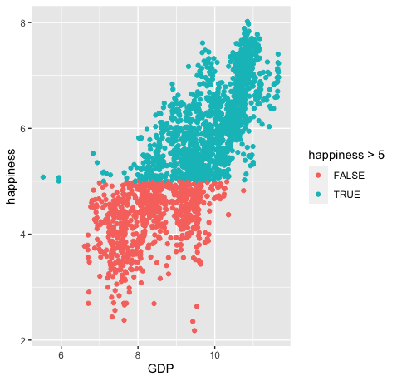
ggplot(happy, aes(GDP, happiness)) +
geom_point()
ggplot(happy, aes(GDP, happiness)) +
geom_point(aes(col=happiness > 5)

Slide 49
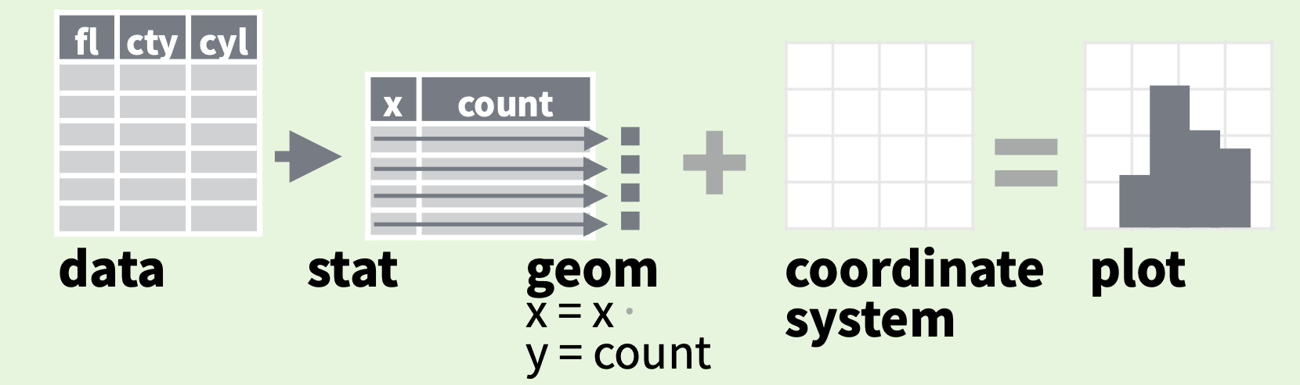
stats
Every geom function specifies a stat
Data
Aesthetics
Geometries
Statistics
Scales
Themes
Exporting

Slide 50
stats
Every geom function specifies a stat
Notes:
For example: If we wanted to make a bar plot that shows how frequently each of the continents is represented in our dataset.

Slide 51
stats
Every geom function specifies a stat
ggplot(happy, aes(continent)) +
geom_bar()
Notes:
ADD INFO ABOUT THE SILENT STAT=SUM

Slide 52
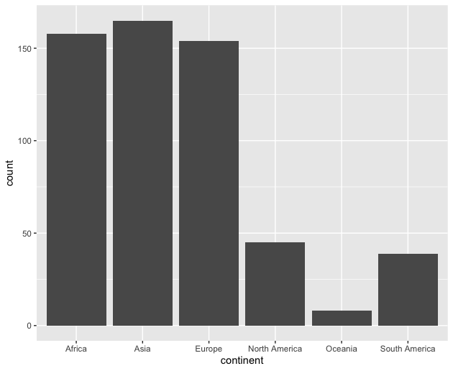
stats
Every geom function specifies a stat
ggplot(happy, aes(continent)) +
geom_bar()

Slide 53
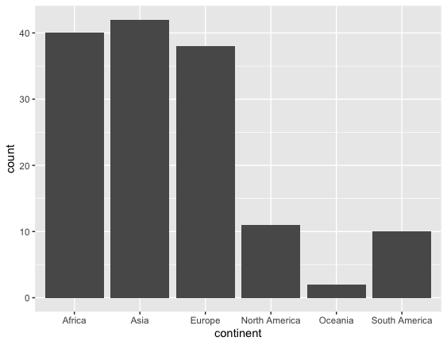
happy |>
filter(year=2019) |>
ggplot(aes(continent)) +
geom_bar()

Slide 54
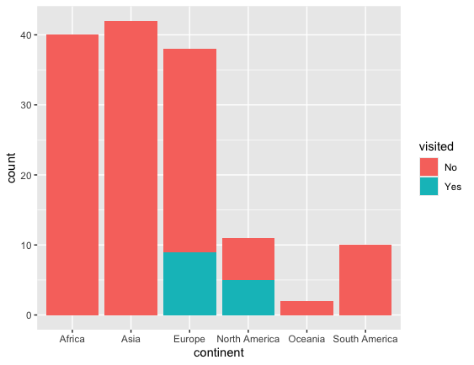
happy |>
filter(year=2019) |>
ggplot(aes(continent)) +
geom_bar(aes(fill=visited)

Slide 55
stat
Every geom function specifies a stat
Use a stat function (calls a default geom to make a layer)
Data
Aesthetics
Geometries
Statistics
Scales
Themes
Exporting

Slide 56
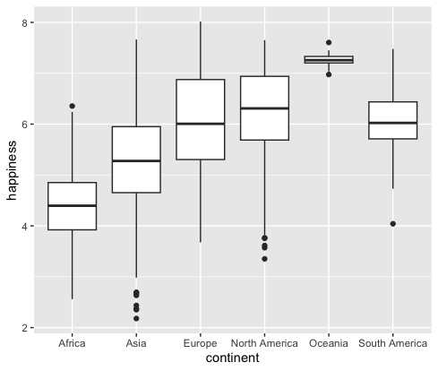
stat
Every geom function specifies a stat
Use a stat function (calls a default geom to make a layer)
ggplot(happy, aes(continent, happiness)) +
geom_boxplot()

Slide 57
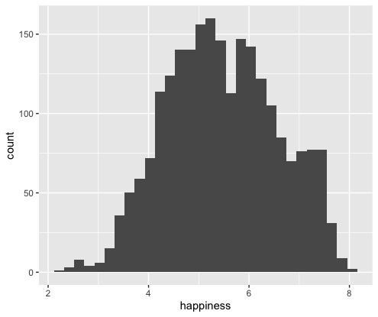
stat
Every geom function specifies a stat
Use a stat function (calls a default geom to make a layer)
ggplot(happy, aes(happiness)) +
geom_histogram()

Slide 58
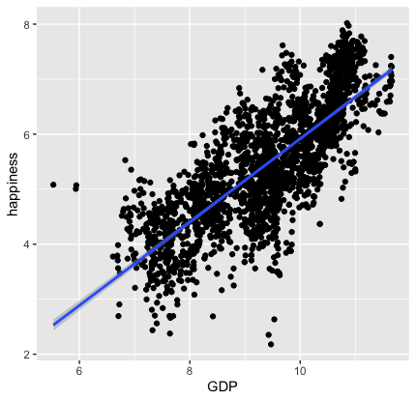
stat
Every geom function specifies a stat
Use a stat function (calls a default geom to make a layer)
ggplot(happy, aes(GDP, happiness)) +
geom_point()+
stat_smooth(method = "lm",
formula = y ~ x)

Slide 59
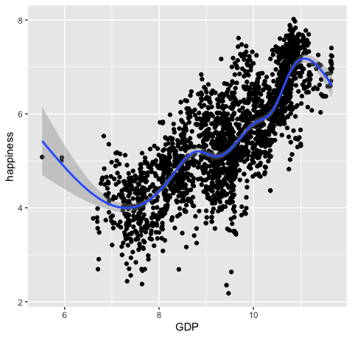
ggplot(happy, aes(GDP, happiness)) +
geom_point() +
geom_smooth()
ggplot(happy, aes(GDP, happiness)) +
geom_point() +
stat_smooth()

Slide 60
Scales
Data
Scales permeate all aspects of plotting in ggplot2
Most defaults will be enough
BUT learning how to manipulate them will give you much more control.
Aesthetics
Geometries
Statistics
Scales
Themes
Exporting

Slide 61
Scales
Data
Scales permeate all aspects of plotting in ggplot2
Most defaults will be enough
BUT learning how to manipulate them will give you much more control.
Aesthetics
Geometries
Statistics
Scales
Themes
Exporting

Slide 62
Scales
Data
Scales permeate all aspects of plotting in ggplot2
Most defaults will be enough
BUT learning how to manipulate them will give you much more control.
Aesthetics
Geometries
Statistics
Scales
Themes
Exporting

Slide 63
Three kinds of scales you are most likely to use:
Axes Limits
Bins
Colors

Slide 64
Three kinds of scales you are most likely to use:
Axes Limits
Bins
Colors
Ill cover these during the live demo portion

Slide 65
Three kinds of scales you are most likely to use:
Axes Limits
Bins
Colors
I want to spend some time talking about color scales

Slide 66
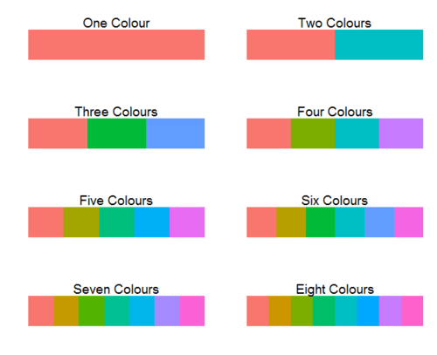
ggplot2 default colors for factors

Slide 67
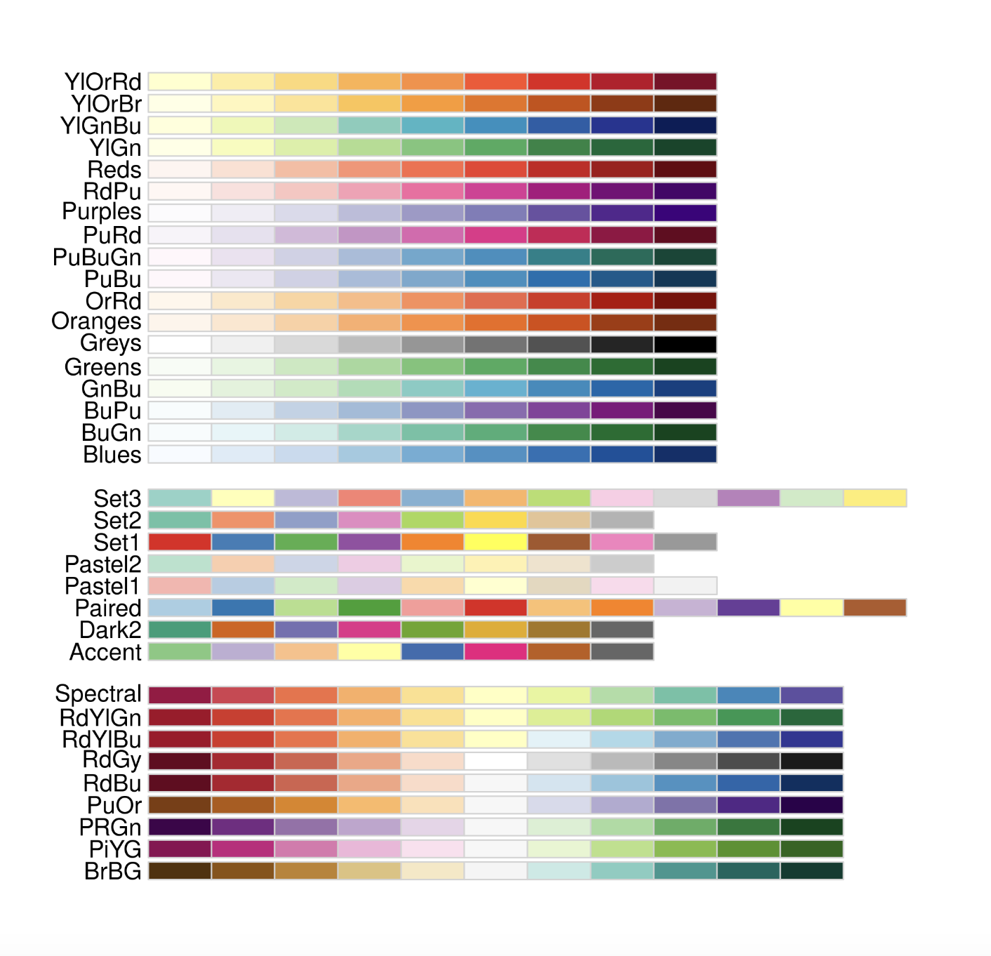
Brewer Scales
Monochrome scales
Qualitative scales
Divergent color scales
Notes:
Qualitative – nominal (no order)

Slide 68
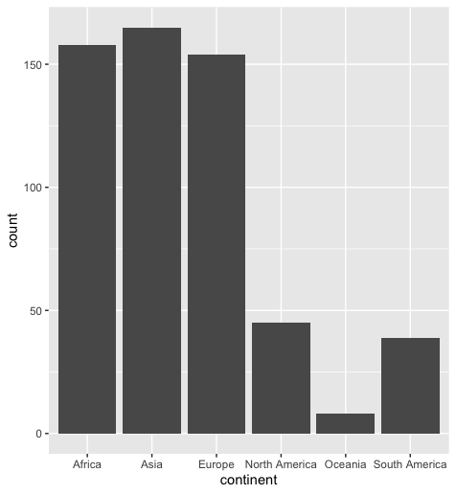
Brewer Scales
ggplot(happy, aes(continent))+
geom_bar()
Notes:
take out col=continent

Slide 69
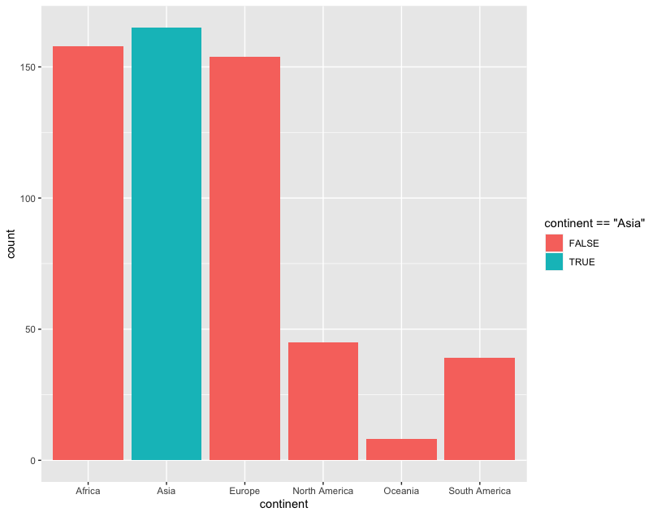
Brewer Scales
ggplot(happy, aes(continent))+
geom_bar(aes(fill=continent==‘Asia’))
Notes:
CORRECT CODE

Slide 70
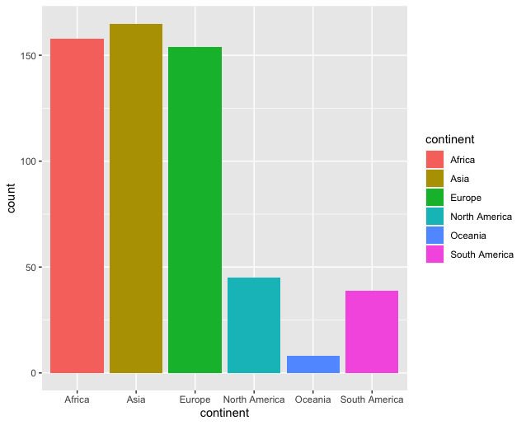
Brewer Scales
ggplot(happy, aes(continent))+
geom_bar(aes(fill=continent==‘Asia’))
Notes:
USE A DIFFERENT EXAMPLE USING A HIGHLIGHT COLOR

Slide 71
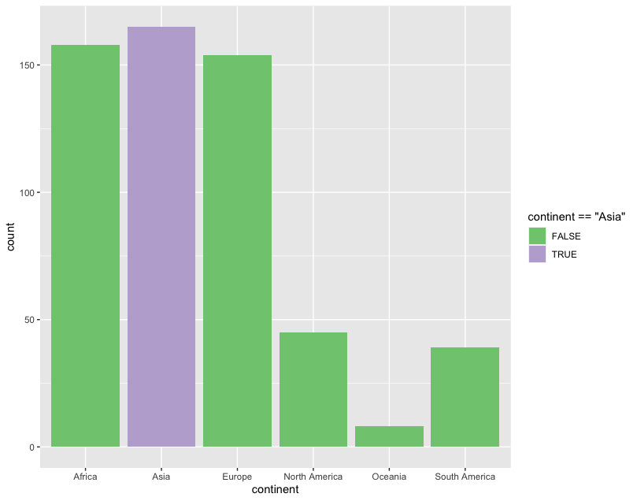
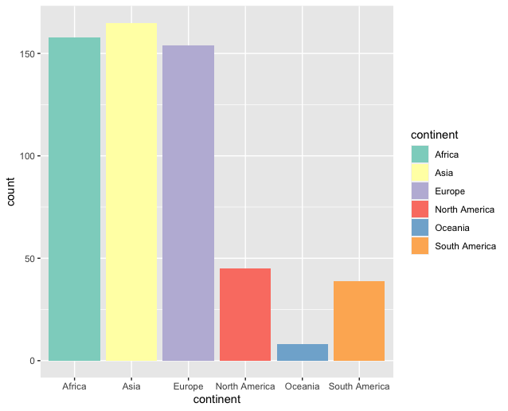
Brewer Scales
ggplot(happy, aes(continent))+
geom_bar(aes(col=continent==‘Asia’))+
scale_fill_brewer(palette = “Accent”)

Slide 72

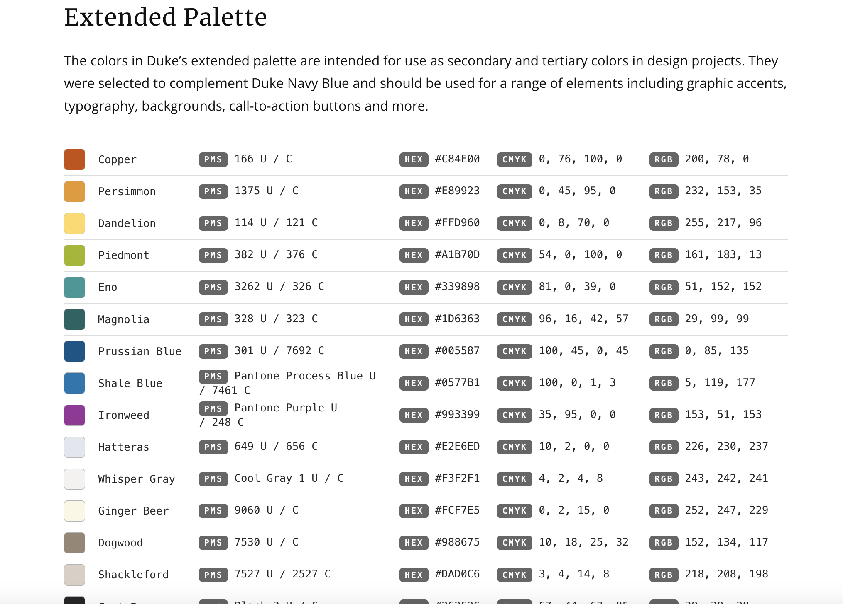
http://brand.duke.edu/colors

Slide 73

http://brand.duke.edu/colors

Slide 74
Custom Scales
Notes:
USE A DIFFERENT EXAMPLE. Add slides showing how you can use neutral and highlight colors

Slide 75
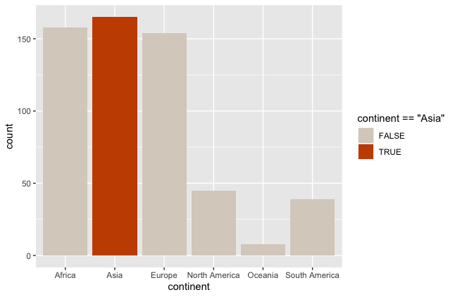
Custom Scales
ggplot(happy, aes(GDP, happiness))+
geom_bar(aes(col=continent==‘Asia’))+
scale_fill_manual(value = DukeColors)
Notes:
USE A DIFFERENT EXAMPLE. Add slides showing how you can use neutral and highlight colors

Slide 76
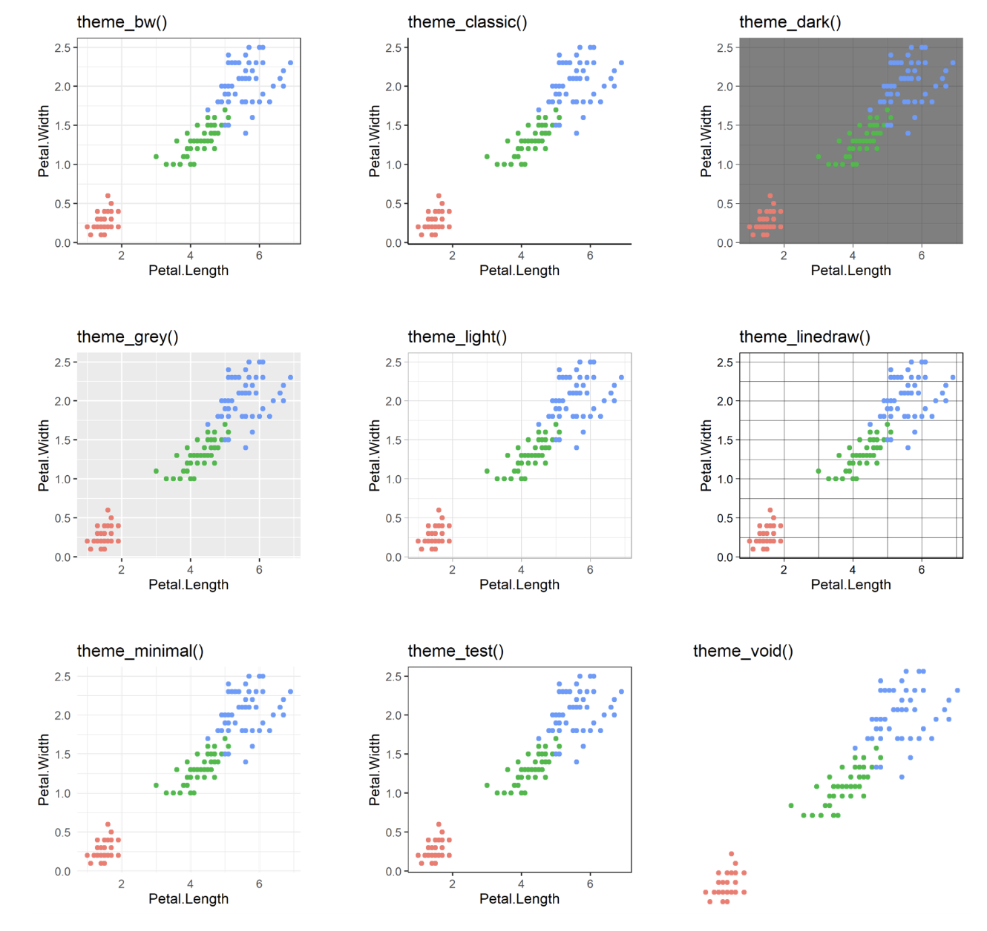
60 preexisting themes
easy to call
Data
Aesthetics
Geometries
Statistics
Scales
Themes
Exporting

Slide 77
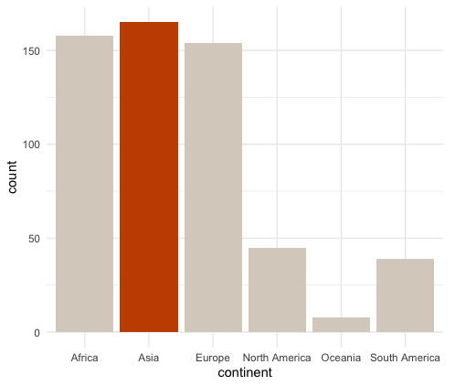
ggplot(happy, aes(GDP, happiness))+ geom_bar(aes(col=continent==‘Asia’))+
scale_fill_manual(value = DukeColors)
ggplot(happy, aes(GDP, happiness))+ geom_bar(aes(col=continent==‘Asia’))+
scale_fill_manual(value = DukeColors)+
theme_minimal()

Slide 78
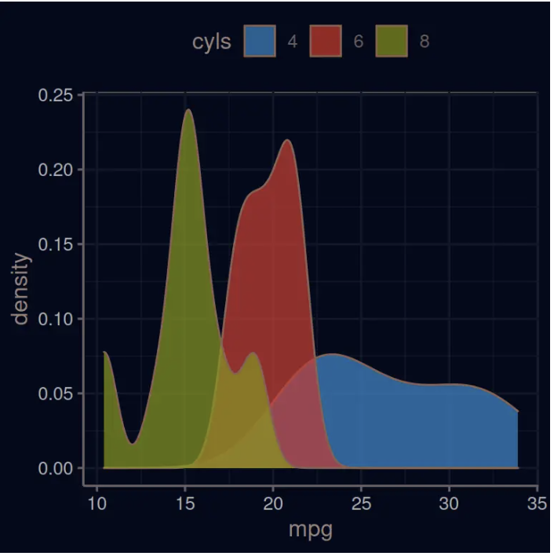
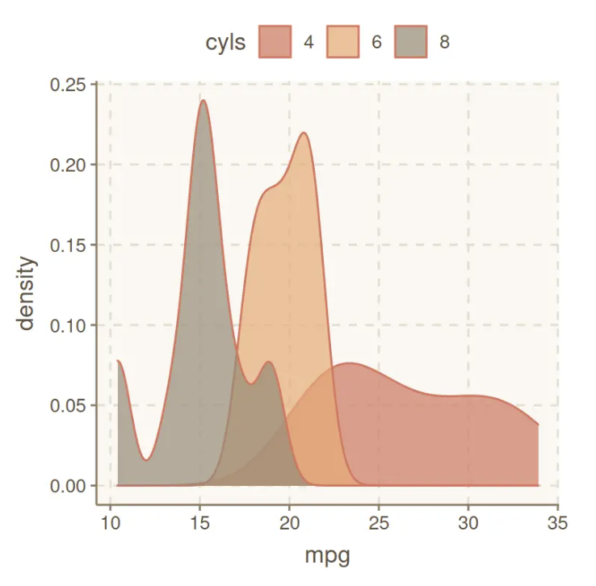
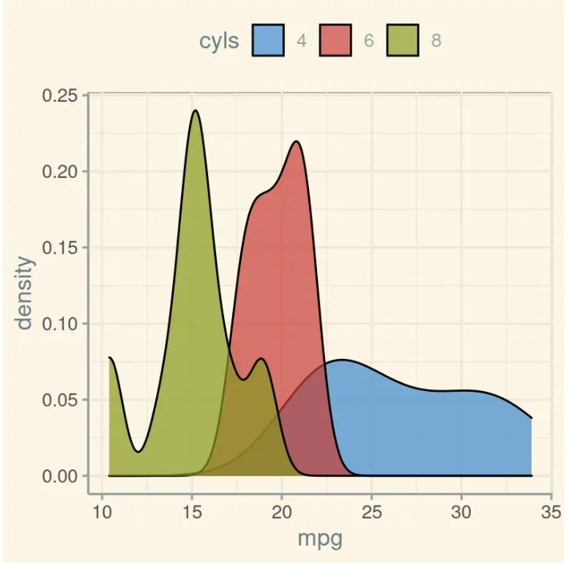
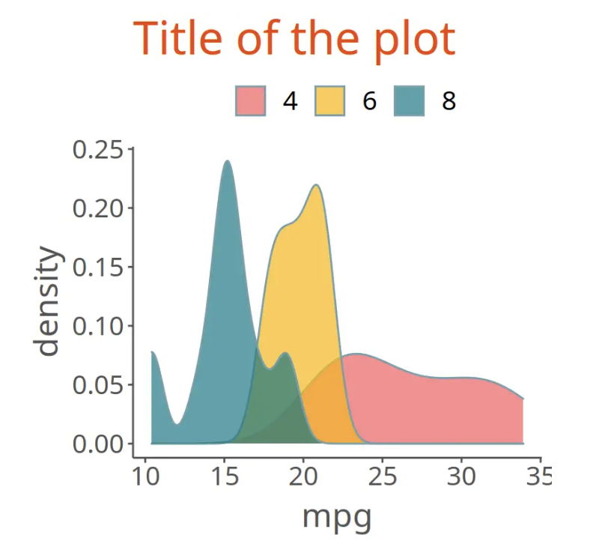
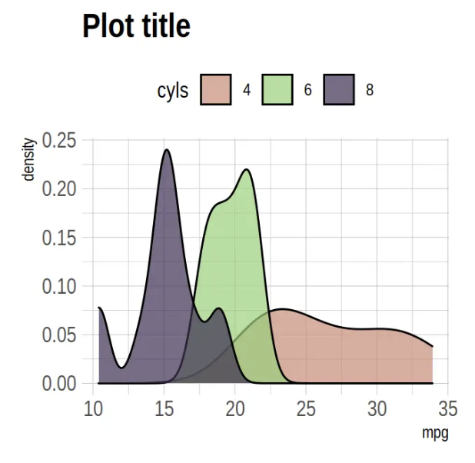
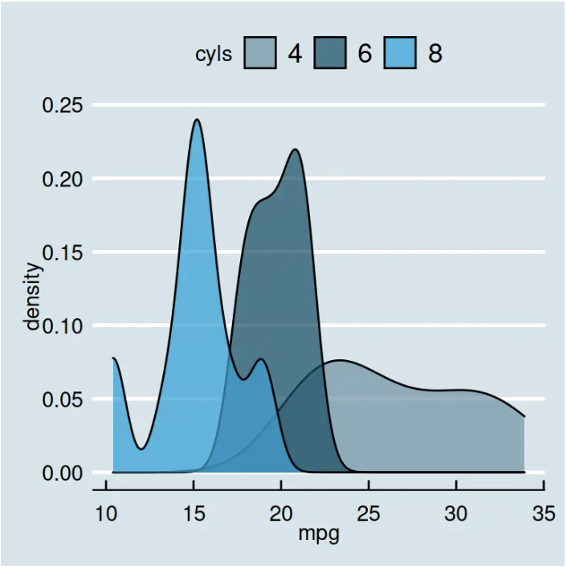
Over 60 pre-existing themes
Data
Aesthetics
Geometries
Statistics
Scales
Themes
Exporting
https://r-charts.com/ggplot2/themes/

Slide 79
60 preexisting themes
easy to call
Data
Aesthetics
Geometries
Statistics
Scales
Themes
Exporting

Slide 80
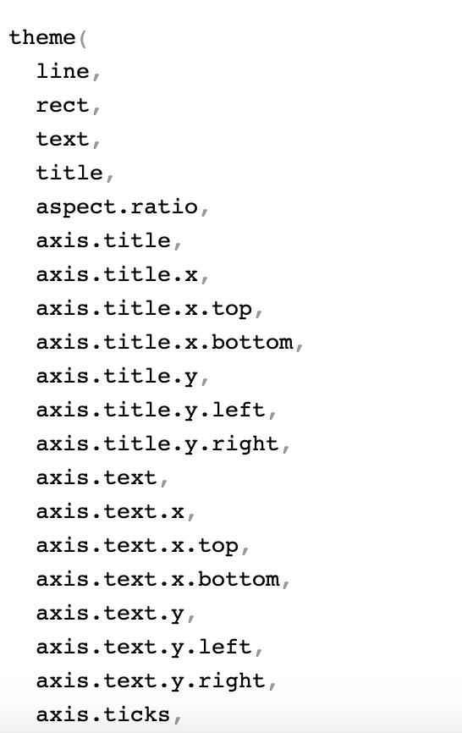



?theme()
…

Slide 81
ggplot(happy, aes(GDP, happiness))+ geom_bar(aes(col=continent==‘Asia’))+
scale_fill_manual(value = DukeColors)+
theme_minimal()

Slide 82

ggplot(happy, aes(GDP, happiness))+ geom_bar(aes(col=continent==‘Asia’))+
scale_fill_manual(value = DukeColors)+
theme_minimal()+
theme(axis.line.x.bottom=element_line(),
axis.line.y.left=element_line()

Slide 83

Data
Aesthetics
Geometries
Statistics
Scales
.pdf
Themes
Exporting

Slide 84


Slide 85
Lets give it a try
github.com/laurennichols/ggplot2_workshop

